Slide 1


RNA-Seq Analysis Workshop Tuxedo and Trinity for Next-Gen Transcriptome Studies
CSHL 2012-10
Brian Haas
Broad Institute
Notes:
I: Lecture ~ 90 mins
--------------------------
1) Generating RNA-Seq data, problems, errors, what biological information is really being captured
Quality filtering of RNA-Seq data, removal of PCR duplicates (appropriate for longer fragment RNA-Seq data)
2) Conceptual differences between de novo transcript-assembly and genome-guided
Include an intro to what transcript assembly means, why we need to do it. What we can learn from it. How it's different from Sanger ESTs (high abundance, but very short reads)
3) Transcript Assembly without a reference genome
Read Normalization, approaches, algorithms, recommendations
Trinity, overview, steps in code (inchworm, chrysalis, butterfly), some algorithm details for each of the steps
Trinity command line details, recommended options, hardware considerations, expected runtime, memory.
Analyzing the transcripts (e.g. differential expression: RSEM, DESeq, other tools)
4) Transcript Assembly with a reference genome
(see http://www.nature.com/nprot/journal/v7/n3/full/nprot.2012.016.html)
Read pre-processing: filtering etc
Tuxedo (Tophat, Cufflinks, Cuffmerge, Cuffdiff, CummerBund) overview, algorithm details (especially bowtie2)
Command line details, recommended options, hardware time and memory considerations.
GFF file format for handling output data, gffread utility
5) General applications of transcript assemblies
Using the transcripts to annotate genomes
Recap on studying differential gene expression
II: Workshop ~ 2-2.5 hrs
---------------------------------
1) With a test dataset limited to a small region of a genome, assemble transcripts with both Trinity and Tuxedo to assemble transcripts from at least two conditions.
2) Look for evidence of differential expression in the transcripts that were just assembled.
3) Consider making plots with e.g. CummerBund or R or other tools.

Slide 2
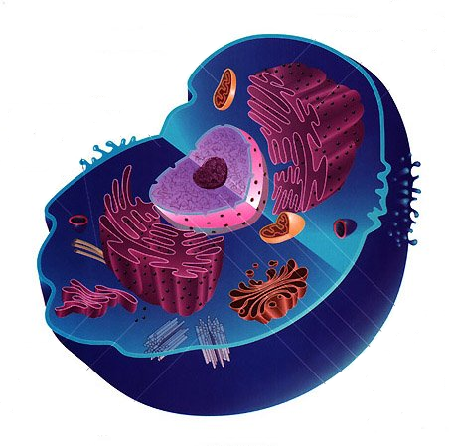
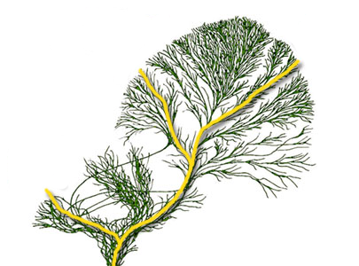
Next-gen Sequencing Transforming Modern Science
Molecular Biology of the Cell
Sequencing Methods
Chromatin structure
Histone occupancy
Transcription factor binding
DNA 3D topology
Genes and transcripts
gene content
alternative splicing
expression
RNA-editing
DNA-Seq
ChIP-Seq
RNA-Seq
Methyl-Seq
Algorithms and Software Tools
Sequence assembly
Polymorphism calling
Gene finding and
transcript reconstruction
Differential Expression analysis
Evolution
Population Genetics
Notes:
Next generation sequencing technologies are rapidly changing the way we do science.
We now have various sequencing methods and algorithms and software tools that are enabling unprecedented insights into the molecular biology of the cell, evolution, and population genetics.
To best make the most use of these technologies, it’s helpful or even necessary to have a reference genome sequence.

Slide 3
RNA-Seq as a Driving Technology
Molecular Biology of the Cell
Sequencing Methods
Chromatin structure
Histone occupancy
Transcription factor binding
DNA 3D topology
Genes and transcripts
gene content
alternative splicing
expression
RNA-editing
DNA-Seq
ChIP-Seq
RNA-Seq
Methyl-Seq
Algorithms and Software Tools
Sequence assembly
Polymorphism calling
Gene finding and
transcript reconstruction
Differential Expression analysis
Evolution
Population Genetics
Notes:
RNA-Seq has become one of the most popular applications of next generation sequencing technology, and it has the advantage that with or without a reference genome, it can provide a cost-effective method to generate significant insights into several research areas.
This is in part due to developments of software to support analyses.

Slide 4
Outline of what’s to follow:
RNA-Seq basics
Analysis paradigms
Genome-based rna-seq studies
Data formats and visualization
De novo transcriptome-based rna-seq studies
Transcript Quantification
Differential Expression Analysis

Slide 5
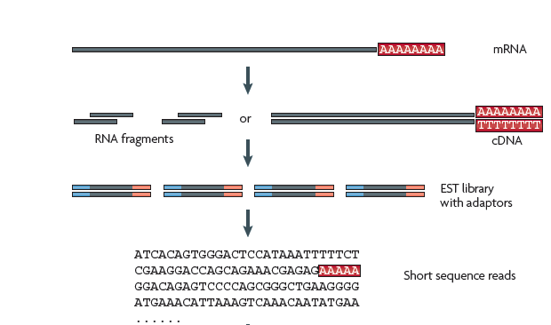
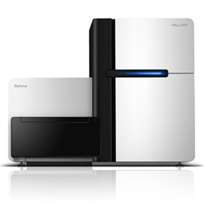
RNA-Sequencing Methodology
*At Broad Institute, typically Illumina 76 or 101 base reads as paired ends
*Adapted from Wang, Gerstein, and Snyder, Nature Reviews Genetics, 2009
Notes:
The RNA-Seq method involves fragmenting full-length transcripts to generate a sequencing library, and then many short reads are sequenced, each typically representing a much smaller region of the original transcript molecule. At the Broad Institute, we usually generate 76 or 101 base illumina reads as paired fragment reads.
A primary challenge towards making use of the RNA-Seq data is to first reconstruct the original transcript from which the fragments were derived.

Slide 6
Common Data Formats for RNA-Seq
FastA format:
>61DFRAAXX100204:1:100:10494:3070/1
AAACAACAGGGCACATTGTCACTCTTGTATTTGAAAAACACTTTCCGGCCAT
FastQ format:
@61DFRAAXX100204:1:100:10494:3070/1
AAACAACAGGGCACATTGTCACTCTTGTATTTGAAAAACACTTTCCGGCCAT
+
ACCCCCCCCCCCCCCCCCCCCCCCCCCCCCBC?CCCCCCCCC@@CACCCCCA
Read
Quality values
AsciiEncodedQual= -10 * log10(Pwrong) + 30
Ascii (‘C’) = 64
So, Pwrong(‘C’) = 10^( (64-30) / (-10) ) = 10^-3.4 = 0.0004

Slide 7
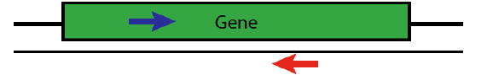
Paired-end Sequences
Two FastQ files, read name indicates left (/1) or right (/2) read of paired-end
@61DFRAAXX100204:1:100:10494:3070/1
AAACAACAGGGCACATTGTCACTCTTGTATTTGAAAAACACTTTCCGGCCAT
+
ACCCCCCCCCCCCCCCCCCCCCCCCCCCCCBC?CCCCCCCCC@@CACCCCCA
@61DFRAAXX100204:1:100:10494:3070/2
CTCAAATGGTTAATTCTCAGGCTGCAAATATTCGTTCAGGATGGAAGAACA
+
C<CCCCCCCACCCCCCCCCCCCCCCCCCCCCCCCCCCCCCCCCCCCCCBCCCC

Slide 8
RNA-Sequencing Methodology
Computational
Reconstruction
*At Broad Institute, typically Illumina 76 or 101 base reads as paired ends
*Adapted from Wang, Gerstein, and Snyder, Nature Reviews Genetics, 2009
Notes:
The RNA-Seq method involves fragmenting full-length transcripts to generate a sequencing library, and then many short reads are sequenced, each typically representing a much smaller region of the original transcript molecule. At the Broad Institute, we usually generate 76 or 101 base illumina reads as paired fragment reads.
A primary challenge towards making use of the RNA-Seq data is to first reconstruct the original transcript from which the fragments were derived.

Slide 9
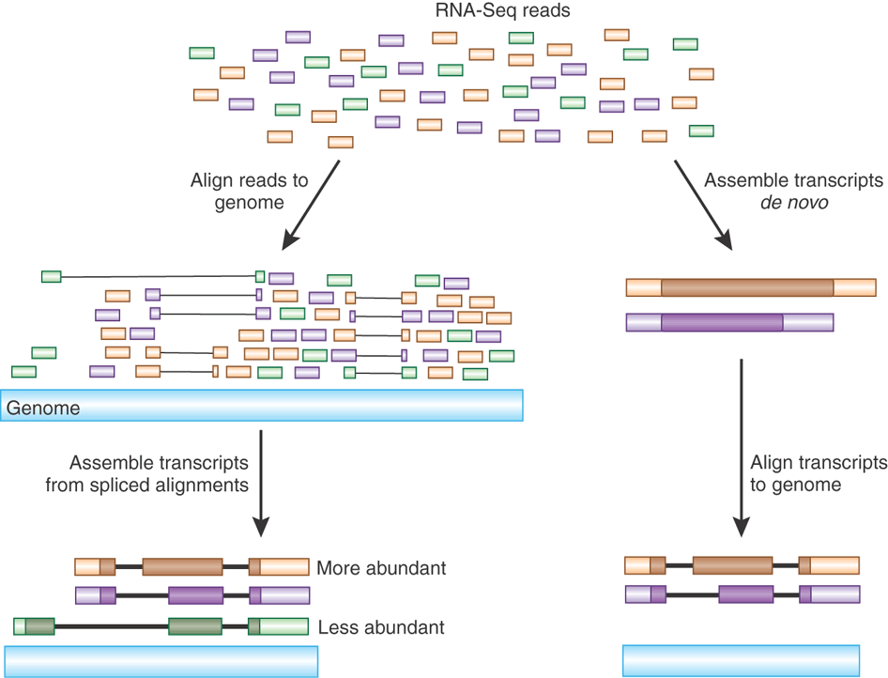
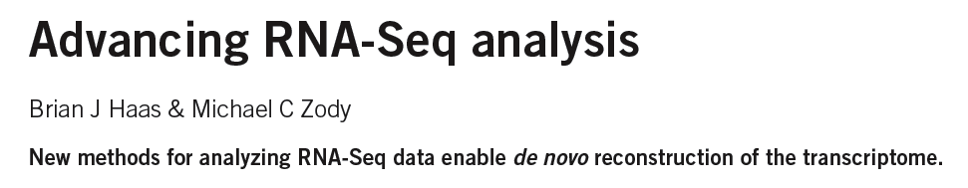
Transcript Reconstruction from RNA-Seq Reads
Nature Biotech, 2010
Notes:
Two general strategies have been explored for reconstructing transcripts from RNA-Seq reads.

Slide 10
Transcript Reconstruction from RNA-Seq Reads
TopHat
Notes:
One strategy requires having a reference genome and involves first aligning reads to the genome using a spliced aligner.

Slide 11
Transcript Reconstruction from RNA-Seq Reads
TopHat
Cufflinks
Notes:
Then, the alignments, instead of the original reads, are assembled into transcript structures.

Slide 12
Transcript Reconstruction from RNA-Seq Reads
TopHat
Trinity
Cufflinks
Notes:
An alternative strategy doesn’t require a reference genome and involves assembling the read sequences directly.

Slide 13
Transcript Reconstruction from RNA-Seq Reads
TopHat
Trinity
Cufflinks
GMAP
Notes:
Then, if a genome sequence is available, the assembled transcripts can be aligned to the genome to reveal individual introns and exons.

Slide 14

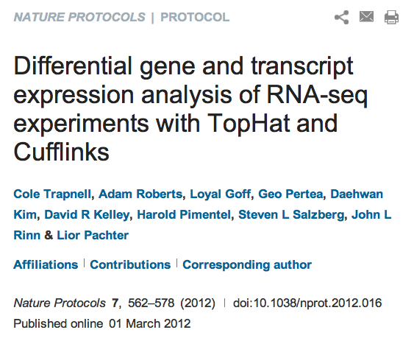

Transcript Reconstruction from RNA-Seq Reads
Trinity
TopHat
The Tuxedo Suite:
End-to-end Genome-based RNA-Seq Analysis Software Package
Cufflinks
GMAP
Notes:
Then, if a genome sequence is available, the assembled transcripts can be aligned to the genome to reveal individual introns and exons.

Slide 15

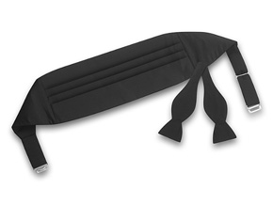
Overview of the Tuxedo Software Suite
Bowtie (fast short-read alignment)
TopHat (spliced short-read alignment)
Cufflinks (transcript reconstruction from alignments)
Cuffdiff (differential expression analysis)
CummeRbund (visualization & analysis)

Slide 16
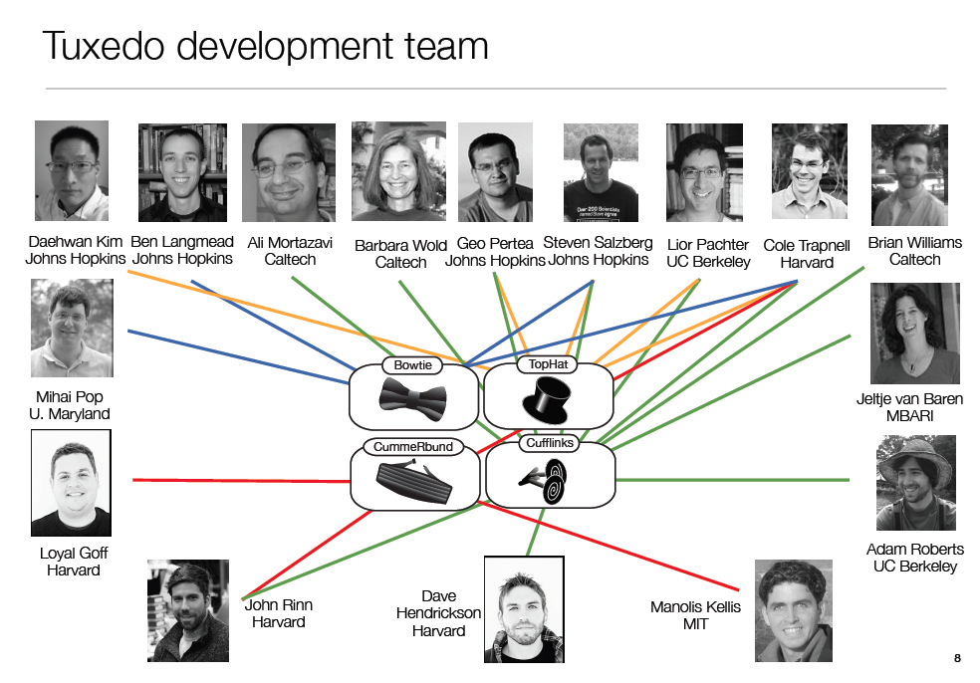
Slide courtesy of Cole Trapnell

Slide 17
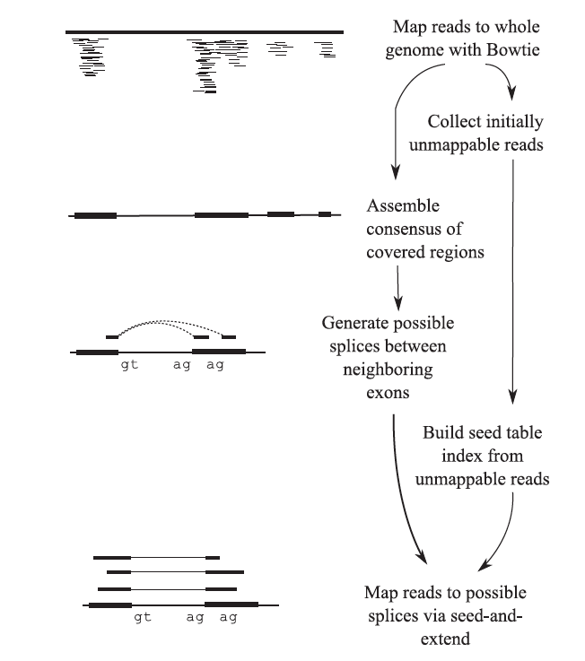
The TopHat Pipeline
From Trapnell, Pachter, & Salzberg. Bioinformatics. 2009

Slide 18
Alignments are reported in a compact representation: SAM format
0 61G9EAAXX100520:5:100:10095:16477
1 83
2 chr1
3 51986
4 38
5 46M
6 =
7 51789
8 -264
9 CCCAAACAAGCCGAACTAGCTGATTTGGCTCGTAAAGACCCGGAAA
10 ###CB?=ADDBCBCDEEFFDEFFFDEFFGDBEFGEDGCFGFGGGGG
11 MD:Z:67
12 NH:i:1
13 HI:i:1
14 NM:i:0
15 SM:i:38
16 XQ:i:40
17 X2:i:0
Link to SAM format description

Slide 19
Alignments are reported in a compact representation: SAM format
(read name)
0 61G9EAAXX100520:5:100:10095:16477
1 83
2 chr1
3 51986
4 38
5 46M
6 =
7 51789
8 -264
9 CCCAAACAAGCCGAACTAGCTGATTTGGCTCGTAAAGACCCGGAAA
10 ###CB?=ADDBCBCDEEFFDEFFFDEFFGDBEFGEDGCFGFGGGGG
11 MD:Z:67
12 NH:i:1
13 HI:i:1
14 NM:i:0
15 SM:i:38
16 XQ:i:40
17 X2:i:0
(FLAGS stored as bit fields; 83 = 00001010011 )
(alignment target)
(position alignment starts)
(Compact description of the alignment in CIGAR format)
(read sequence, oriented according to the forward alignment)
(base quality values)
(Metadata)
Link to SAM format description

Slide 20
Alignments are reported in a compact representation: SAM format
(read name)
0 61G9EAAXX100520:5:100:10095:16477
1 83
2 chr1
3 51986
4 38
5 46M
6 =
7 51789
8 -264
9 CCCAAACAAGCCGAACTAGCTGATTTGGCTCGTAAAGACCCGGAAA
10 ###CB?=ADDBCBCDEEFFDEFFFDEFFGDBEFGEDGCFGFGGGGG
11 MD:Z:67
12 NH:i:1
13 HI:i:1
14 NM:i:0
15 SM:i:38
16 XQ:i:40
17 X2:i:0
(FLAGS stored as bit fields; 83 = 00001010011 )
(alignment target)
(position alignment starts)
Still not compact enough…
Millions to billions of reads takes up a lot of space!!
Convert SAM to binary – BAM format.
(Compact description of the alignment in CIGAR format)
(read sequence, oriented according to the forward alignment)
(base quality values)
(Metadata)
Link to SAM format description

Slide 21
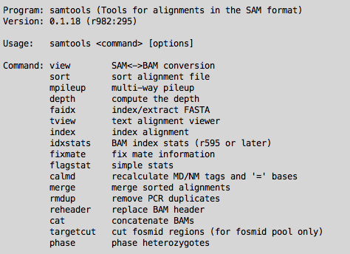
Samtools
Tools for
converting SAM <-> BAM
Viewing BAM files (eg. samtools view file.bam | less )
Sorting BAM files, and lots more:

Slide 22
Visualizing Alignments of RNA-Seq reads

Slide 23
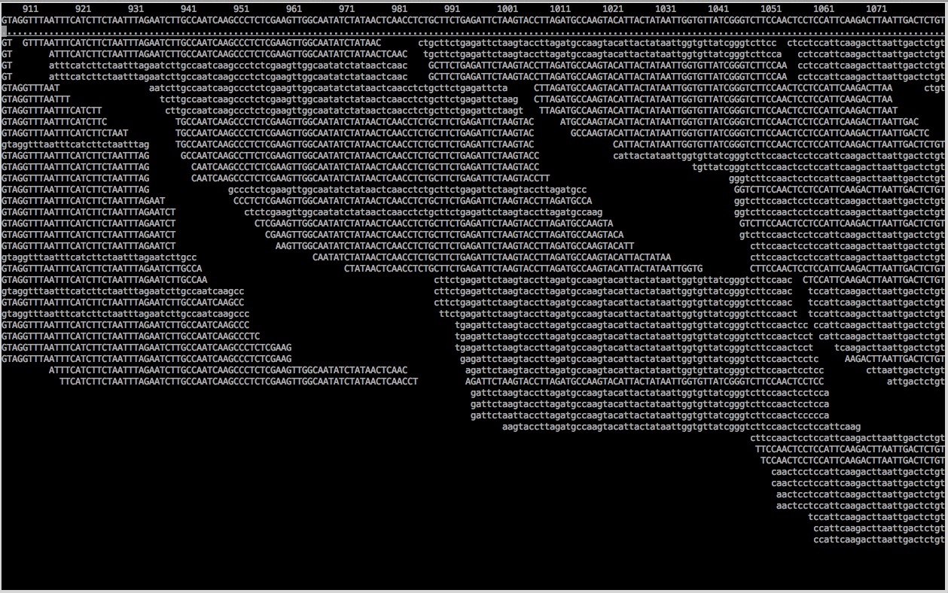
Text-based Alignment Viewer
% samtools tview alignments.bam target.fasta

Slide 24
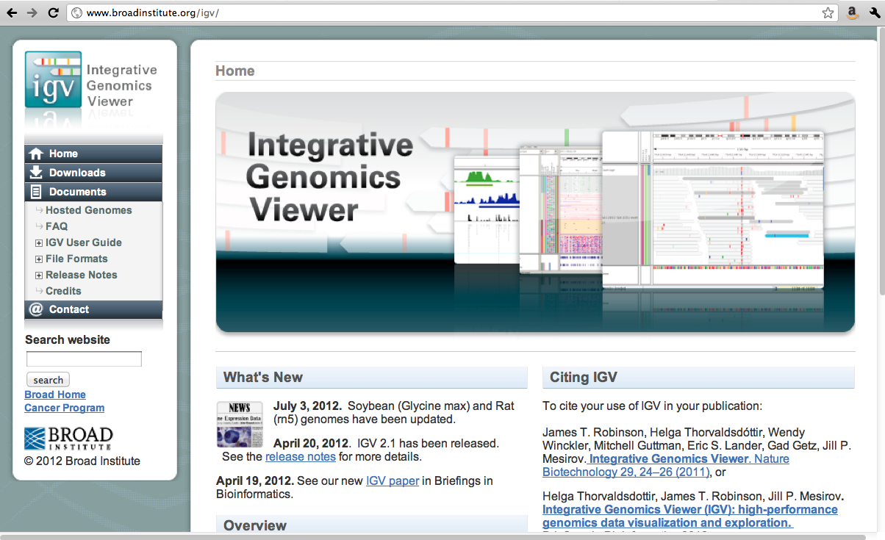
IGV

Slide 25
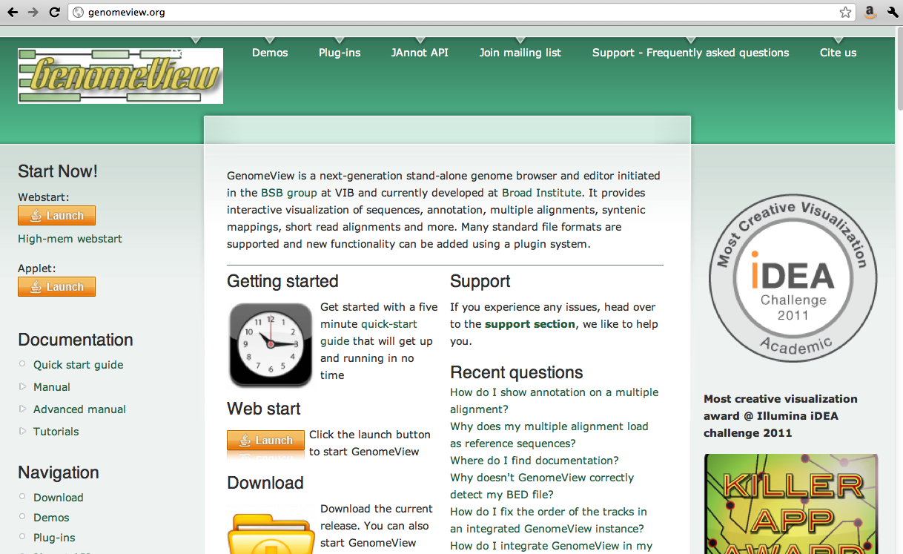
GenomeView

Slide 26
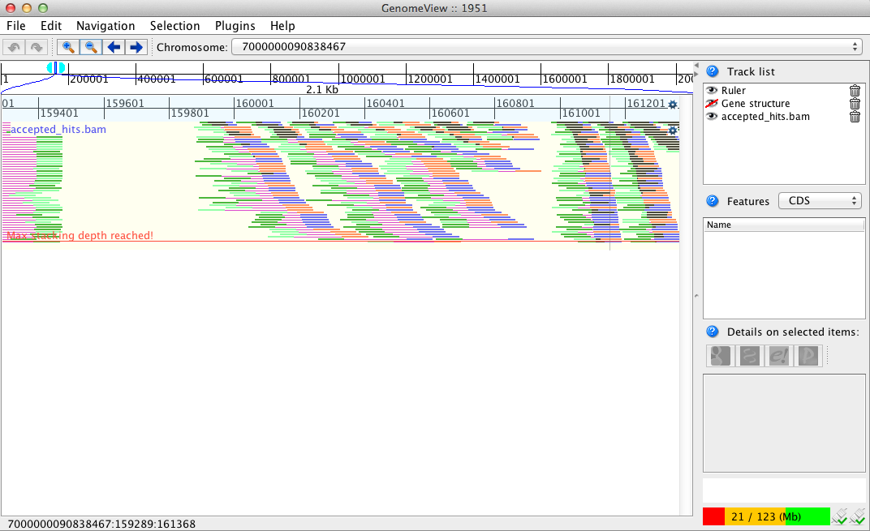
GenomeView: viewing TopHat alignments

Slide 27
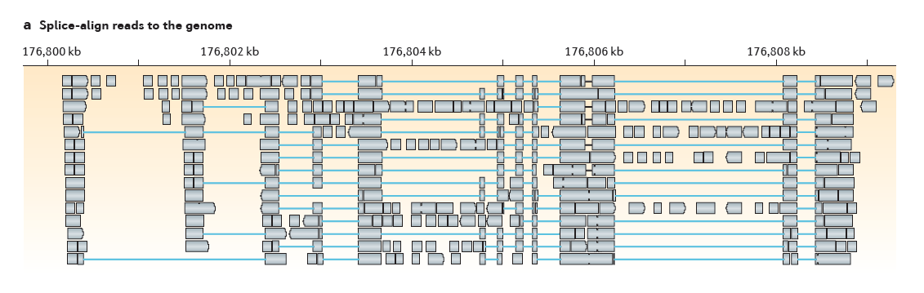
Transcript Reconstruction Using Cufflinks
From Martin & Wang. Nature Reviews in Genetics. 2011

Slide 28
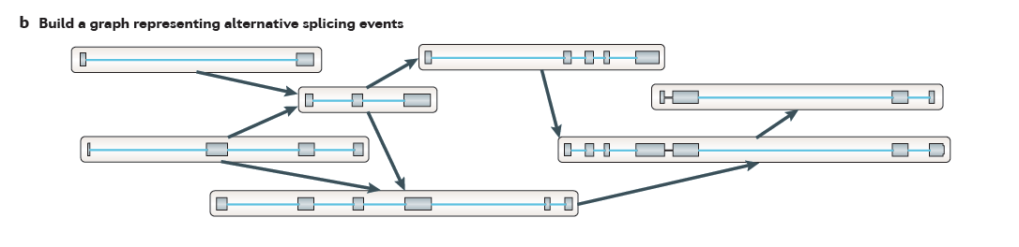
Transcript Reconstruction Using Cufflinks
From Martin & Wang. Nature Reviews in Genetics. 2011

Slide 29
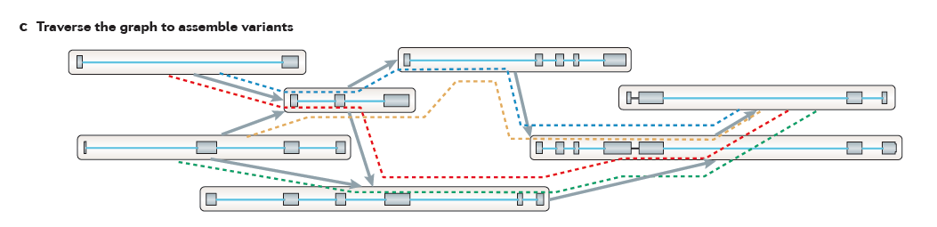
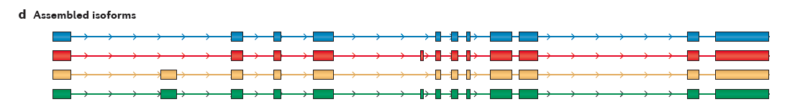
Transcript Reconstruction Using Cufflinks
From Martin & Wang. Nature Reviews in Genetics. 2011

Slide 30
Transcript Structures in GTF Format (tab-delimited fields per line shown transposed to a column format here)
(genomic contig identifier)
0 7000000090838467
1 Cufflinks
2 transcript
3 101
4 5716
5 1000
6 +
7 .
8 gene_id "CUFF.1"; transcript_id "CUFF.1.1"; FPKM "378.0239937260“
0 7000000090838467
1 Cufflinks
2 exon
3 101
4 5716
5 1000
6 +
7 .
8 gene_id "CUFF.1"; transcript_id "CUFF.1.1"; exon_number "1"; FPKM "378.0239937260“
(left coordinate)
(right coordinate)
(strand)
(annotations)

Slide 31
De novo transcriptome assembly
No genome required
Empower studies of non-model organisms
expressed gene content
transcript abundance
differential expression

Slide 32
Transcript Reconstruction from RNA-Seq Reads
TopHat
Trinity
Cufflinks
GMAP
Notes:
Then, if a genome sequence is available, the assembled transcripts can be aligned to the genome to reveal individual introns and exons.

Slide 33
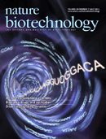


Transcript Reconstruction from RNA-Seq Reads
Trinity
Grabherr, Haas, & Yassour et al., Nature Biotechnology, 2011
How it works.
Applications of interest.
Notes:
Trinity is a software tool that I helped develop, and which we published last year in Nature Biotechnology.
In this talk, I’ll describe how Trinity works, and describe some of the applications that we aim to support.

Slide 34
Short Read Assembly Using de Bruijn Graphs
Target
….GATCAGCAGGTCCAGACGT……
….GATCAGCA
Reads
AGCAGGTCCAG
CCAGACGT……
…-GATC-ATCA-TCAG-CAGC-AGCA
De Bruijn
Graph Construction
(K=4)
Notes:
Trinity, like most all short-read assembly tools, uses a de Bruijn graph-based method to assemble sequences.
The assembly process begins by decomposing the sequencing reads into sets of overlapping kmers, and assigning each kmer as a node in the graph. In this example, we set k = 4. Each 4-mer is made a node in the graph, and the immediately overlapping k-mers are linked together by an edge.

Slide 35
Short Read Assembly Using de Bruijn Graphs
Target
….GATCAGCAGGTCCAGACGT……
….GATCAGCA
Reads
AGCAGGTCCAG
CCAGACGT……
…-GATC-ATCA-TCAG-CAGC-AGCA
De Bruijn
Graph Construction
(K=4)
AGCA-GCAG-CAGG-AGGT
-GGTC-GTCC-TCCA-CCAG
Notes:
Each read is deconstructed this way, and identical kmers are assigned to the same node in the graph.

Slide 36
Short Read Assembly Using de Bruijn Graphs
Target
….GATCAGCAGGTCCAGACGT……
….GATCAGCA
Reads
AGCAGGTCCAG
CCAGACGT……
…-GATC-ATCA-TCAG-CAGC-AGCA
De Bruijn
Graph Construction
(K=4)
AGCA-GCAG-CAGG-AGGT
-GGTC-GTCC-TCCA-CCAG
CCAG-CAGA-AGAC-GACG-ACGT-….
Notes:
Once all reads have been processed this way and the graph is complete, the original target molecule, be it a genome or a transcript, is reconstructed…

Slide 37
Short Read Assembly Using de Bruijn Graphs
Target
….GATCAGCAGGTCCAGACGT……
….GATCAGCA
Reads
AGCAGGTCCAG
CCAGACGT……
…-GATC-ATCA-TCAG-CAGC-AGCA
De Bruijn
Graph Construction
(K=4)
AGCA-GCAG-CAGG-AGGT
-GGTC-GTCC-TCCA-CCAG
CCAG-CAGA-AGAC-GACG-ACGT-….
Sequence Reconstruction
By Path Traversal
….GATCAGCAGGTCCAGACGT……
Notes:
…by traversing paths of connected nodes in the graph.

Slide 38
Contrasting Genome and Transcriptome Assembly
Genome Assembly
Transcriptome Assembly
Uniform coverage
Single contig per locus
Double-stranded
Exponentially distributed coverage levels
Multiple contigs per locus (alt splicing)
Strand-specific
Notes:
Although the underlying data structure for assembly is quite similar for genome and transcriptome assembly, there are some critical differences between the expectations of the two and that explain why tools developed for genome assembly are mostly unfit for transcriptome assembly.
Genome assemblers expect that read coverage is going to be uniform and will often discard sequences that occur at high coverage as repetitive sequences. Transcriptome assembly needs to consider a wide range of coverage levels since sequences with high coverage are more likely to represent highly expressed transcripts instead of repeats.
Genome assemblers aim to generate a single contig per locus, possibly two if tuned to separate haplotypes in a polymorphic genome assembly. There’s no such expectation in transcriptome assembly since it’s understood that single genes can generate many alternatively spliced transcripts.
Finally, in genome assembly, reads are assumed to be derived from either strand of the double-stranded DNA molecule. Given strand-specific RNA-Seq reads, Transcriptome assemblers should aim to assemble sense and antisense transcripts separately.
Trinity, of course, was developed to take all of these properties into account.

Slide 39
Trinity Aggregates Isolated Transcript Graphs
Genome Assembly
Single Massive Graph
Trinity Transcriptome Assembly
Many Thousands of Small Graphs
Entire chromosomes represented.
Ideally, one graph per expressed gene.
Notes:
A significant difference between Trinity as compared to all other genome and transcriptome assemblers is how it goes about building the graphs.
Genome assemblers (and other transcriptome assemblers that are built on top of genome assemblers) build single large graphs.
Trinity instead tries to partition the data into many thousands of small graphs, ideally one graph per expressed gene. This is possible because most expressed transcripts are expected to be non-overlapping.
Having many small graphs lends itself to massive parallel processing, which is an added computational benefit.

Slide 40
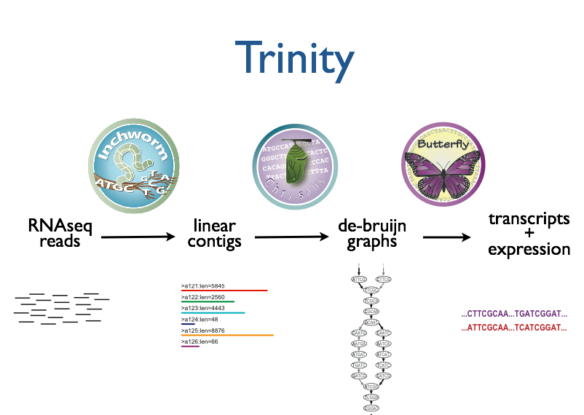



RNA-Seq reads
Linear
contigs
de-Bruijn
graphs
Transcripts
+
Isoforms
Notes:
We call it Trinity because it involves three major steps that we’ve built into three separate software tools.
It starts with Inchworm, which first assembles the RNA-Seq data into linear contigs.
Then, Chrysalis groups contigs that are related due to alternative splicing or gene duplication and constructs de bruijn graphs.
Finally, Butterfly examines reads in the context of the de bruijn graphs, reporting the final full-length transcripts and isoforms of transcripts.

Slide 41
Inchworm Algorithm
Decompose all reads into overlapping Kmers (25-mers)
Identify seed kmer as most abundant Kmer, ignoring low-complexity kmers.
Extend kmer at 3’ end, guided by coverage.
G
A
GATTACA
9
T
C
Notes:
The inchworm algorithm works as follows:
It first decomposes reads into a catalog of overlapping Kmers. By default we use overlapping 25-mers.
The single most abundant kmer with reasonable sequence complexity is identified as a seed kmer.
This seed kmer is then extended at the 3’ end guided by the coverage of overlapping kmers.
For each extension, there are four possible kmers, each ending with one of the four possible nucleotides.

Slide 42
Inchworm Algorithm
G
4
A
GATTACA
9
T
C
Notes:
Each of the possible overlapping kmers is looked up in the kmer catalog to determine their frequency within the reads.
In this toy example, the kmer ending with ‘G’ is found 4 times.

Slide 43
Inchworm Algorithm
G
4
A
GATTACA
1
9
T
C
Notes:
‘A’ is found once.

Slide 44
Inchworm Algorithm
G
4
A
GATTACA
1
9
T
0
C
Notes:
The kmer ending with ‘T’ doesn’t exist in the reads, so it has a count of zero.

Slide 45
Inchworm Algorithm
G
4
A
GATTACA
1
9
T
0
C
4
Notes:
And the kmer ending with ‘C’ is found 4 times.

Slide 46
Inchworm Algorithm
G
4
A
GATTACA
1
9
T
0
C
4
Notes:
In this case we have a tie.

Slide 47
Inchworm Algorithm
G
A
0
5
T
1
G
4
C
A
0
GATTACA
1
9
T
0
G
C
1
4
A
1
C
T
1
1
Notes:
When we encounter a tie, we explore the tied paths recursively to find the extension providing the highest cumulative coverage.

Slide 48
Inchworm Algorithm
G
A
0
5
T
1
G
4
C
A
0
GATTACA
1
9
T
0
G
C
1
4
A
1
C
T
1
1
Notes:
In this case, the extension of two overlapping kmers ending with an ‘A’ provides the highest scoring path, and so the other paths are ignored.

Slide 49
Inchworm Algorithm
A
5
G
4
GATTACA
9
Notes:
Extensions continue to occur in this way until there are no more kmers that provide for an extension.

Slide 50
Inchworm Algorithm
A
5
C
G
0
4
T
0
GATTACA
A
9
6
G
1
Notes:
Then, we extend from right to left in the same manner, following the path of greatest coverage.

Slide 51
Inchworm Algorithm
A
5
G
4
GATTACA
A
9
6
A
7
Report contig: ….AAGATTACAGA….
Remove assembled kmers from catalog, then repeat the entire process.
Notes:
Once the extension completes, the assembled contig is reported.
--transition—
The kmers found in the contig are removed from the kmer catalog, and the entire process is repeated starting from a new seed.

Slide 52

Inchworm Contigs from Alt-Spliced Transcripts
Notes:
Inchworm performs very well at reconstructing full-length transcripts, but in the case of alternative splicing, inchworm alone is unable to reconstruct full-length transcripts for each of the isoforms.
This is because it assembles contigs from unique kmers and the sequences shared between isoforms can be reported in only one contig.

Slide 53
Inchworm Contigs from Alt-Spliced Transcripts
Notes:
Inchworm will often report a more highly expressed isoform as a single full-length contig.

Slide 54
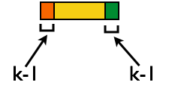
Inchworm Contigs from Alt-Spliced Transcripts
+
Notes:
And the unique regions of alternatively spliced isoforms are reported as separate contigs.

Slide 55
Inchworm Contigs from Alt-Spliced Transcripts
+
Notes:
Although these inchworm contigs lack complete kmers in common, they maintain partial kmer overlap at points where the isoforms diverge.
The smaller contig can still be associated with the larger contig based on these partial kmers of length k-1, and we can find reads to support the junction.
The Chrysalis tool, in the next step, exploits these partial kmers to regroup related contigs.

Slide 56
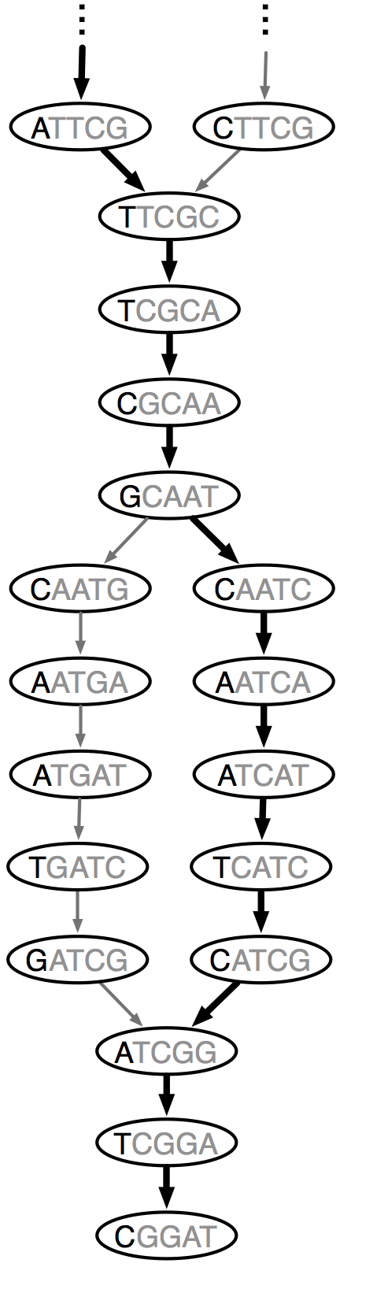
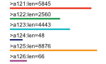
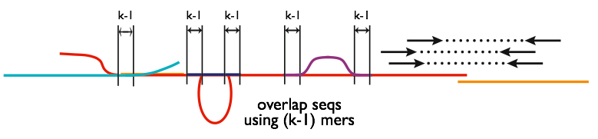
Chrysalis
Integrate isoforms
via k-1 overlaps
Build de Bruijn Graphs
(ideally, one per gene)
Notes:
In the next step, Chrysalis clusters related contigs based on these k-1mer overlaps.
Chyrsalis also leverages read pairing information to join minimally overlapping contigs.
After identifying the connected inchworm contigs, it constructs a separate de Bruijn graph for each group.
(The de Bruijn graph represents the overlaps between adjacent kmers in the sequences with branches at sequencing variations.)
In many cases, we end up with one graph per gene, with each graph representing the transcriptional complexity at that locus.
These graphs can then be processed in a parallel fashion by the next step involving Butterfly.

Slide 57
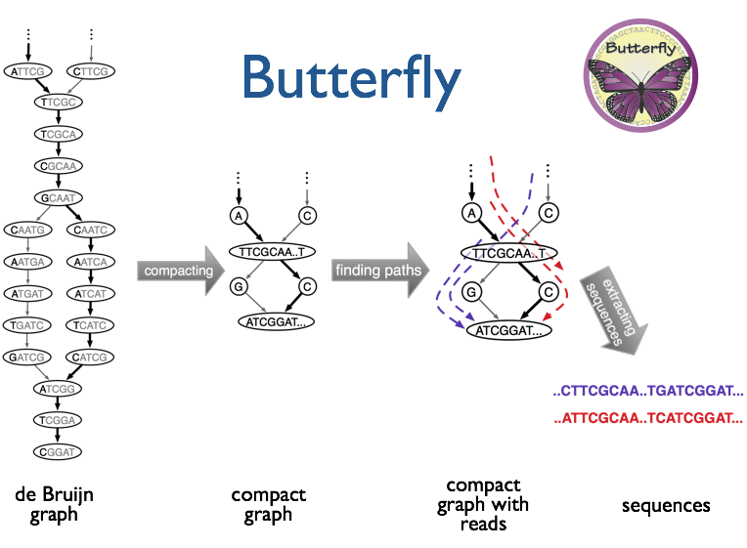
(isoforms and paralogs)
Notes:
Butterfly operates on each of these graphs independently.
It first compacts the de Bruijn graph by collapsing the unbranched streteches.
It then threads the original sequencing reads into the graph, tracking the paths occupied by the reads and the pairings.
Butterfly then reports the most probable paths through the graph supported by the reads and read pairings, emitting full-length transcripts for isoforms and paralogs.

Slide 58
Graph Components
= “Genes”
Sequences
= “isoforms”
(isoforms and paralogs)
Notes:
Butterfly operates on each of these graphs independently.
It first compacts the de Bruijn graph by collapsing the unbranched streteches.
It then threads the original sequencing reads into the graph, tracking the paths occupied by the reads and the pairings.
Butterfly then reports the most probable paths through the graph supported by the reads and read pairings, emitting full-length transcripts for isoforms and paralogs.

Slide 59
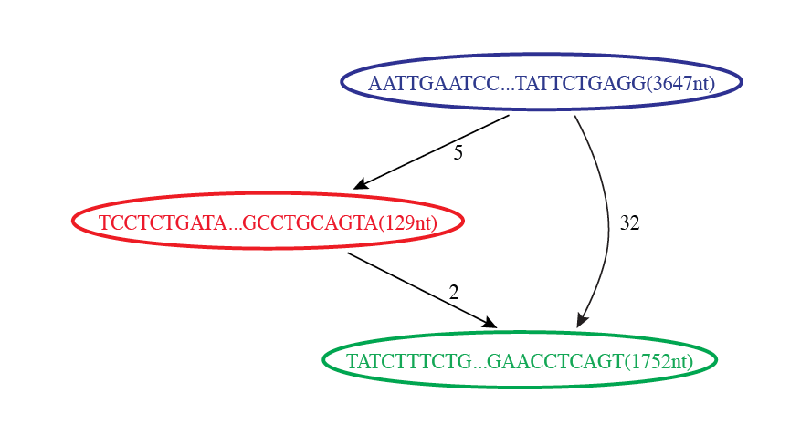

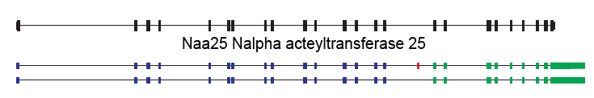
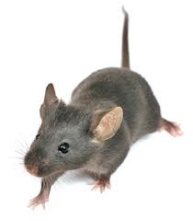
Reconstruction of Alternatively Spliced Transcripts
Butterfly’s Compacted Sequence Graph
Reconstructed Transcripts
Aligned to Mouse Genome
Notes:
By traversing the path from the top blue node to the bottom green node, we generate a single transcript sequence.

Slide 60
Reconstruction of Alternatively Spliced Transcripts
Butterfly’s Compacted Sequence Graph
Reconstructed Transcripts
Aligned to Mouse Genome
Notes:
By traversing the alternative path through the red node, we generate another transcript sequence. This second transcript shares the blue and green segments, but contains an additional internal red segment.

Slide 61
Reconstruction of Alternatively Spliced Transcripts
Butterfly’s Compacted Sequence Graph
Reconstructed Transcripts
Aligned to Mouse Genome
(Reference structure)
Notes:
From mapping the transcripts to the reference genome sequence we can see that the inserted sequence actually corresponds to a cassette exon that is alternatively spliced, and novel given that it wasn’t found in the reference transcript structure.

Slide 62
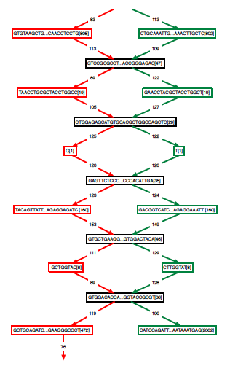
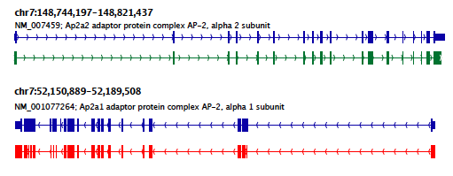
Teasing Apart Transcripts of Paralogous Genes
Ap2a1
Ap2a2
Notes:
Some transcript graphs are far more complex.
Here we have an example of two such transcripts derived from paralogous genes that became intertwined in the compacted graph due to stretches of sequence identity among segments of the transcripts.
Shared sequences are represented by the central sequence nodes and paralog-specific sequences are represented by branched nodes.
By tracing consistent paths of reads through the graph, Butterfly is able to tease apart the paralogous gene sequences and report the individual transcripts. In this case, the green path yields one of the transcripts and the red path yields the other.

Slide 63
Teasing Apart Transcripts of Paralogous Genes
Ap2a1
Ap2a2
Notes:
These transcripts, when mapped to the mouse genome match perfectly with the reference gene structures.

Slide 64
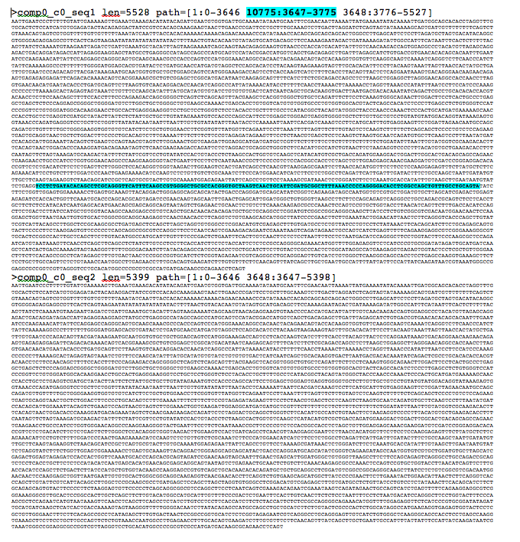
Trinity output: A multi-fasta file

Slide 65
Abundance Estimation (Aka. Computing Expression Values)

Slide 66
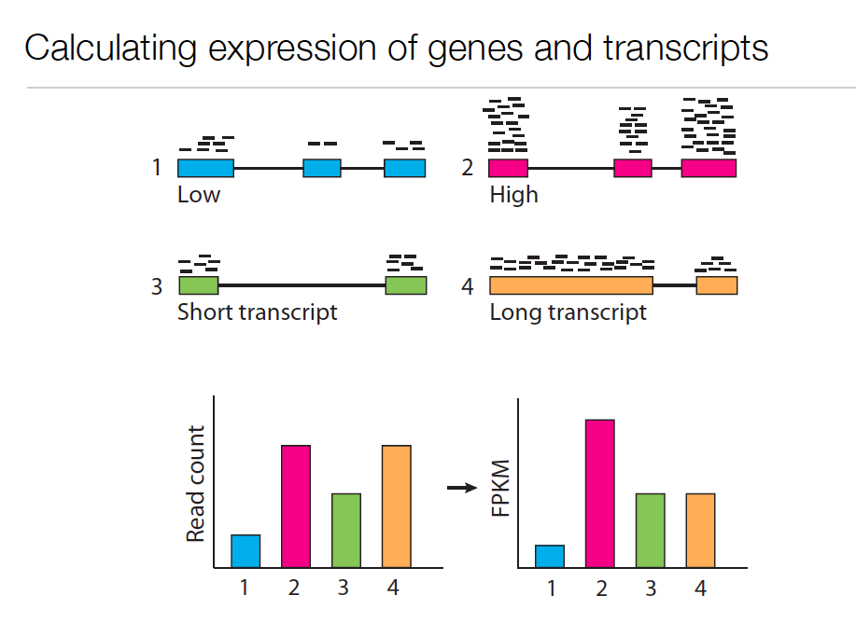
Expression Value
Slide courtesy of Cole Trapnell

Slide 67
Expression Value
Slide courtesy of Cole Trapnell

Slide 68
Normalized Expression Values
Normalized for both length of the transcript and total depth of sequencing.
Number of RNA-Seq Fragments Per Kilobase of transcript per total Million fragments mapped
FPKM
Note, RPKM : Reads per … instead of Fragments is often used with single-end reads.

Slide 69
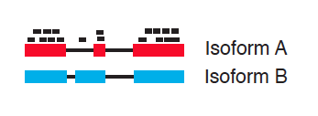
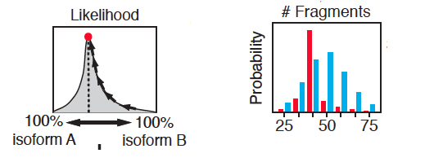
Sophisticated computations are required to estimate isoform expression where there is read mapping ambiguity.
Model considers unique and ambiguously mapping reads and the length of transcripts.
Illustrations courtesy of Cole Trapnell

Slide 70
Sophisticated computations are required to estimate isoform expression where there is read mapping ambiguity.
Model considers unique and ambiguously mapping reads and the length of transcripts.
Illustrations courtesy of Cole Trapnell

Slide 71
Tools that perform abundance estimation
Cuffdiff
RSEM
0 tracking_id
1 class_code
2 nearest_ref_id
3 gene_id
4 gene_short_name
5 tss_id
6 locus
7 length
8 coverage
9 condA_FPKM
10 condA_conf_lo
11 condA_conf_hi
12 condA_status
XLOC_000001
-
-
XLOC_000001
-
TSS1
Chr1:180422-180902
-
-
10042.1
0
20319.6
OK
0 transcript_id
1 gene_id
2 length
3 effective_length
4 expected_count
5 TPM
6 FPKM
7 IsoPct
comp100_c0_seq1
comp100_c0
727
534.74
14.00
328.11
532.77
100.00

Slide 72
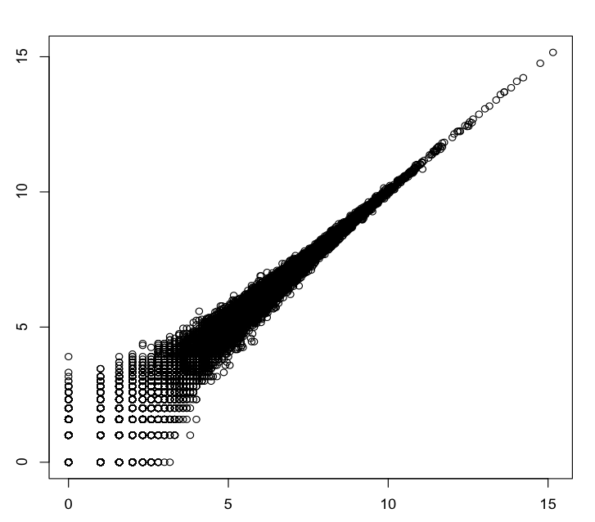
Technical Replicates
R^2=0.999
Log2(rep2_counts+1)
Kidney rna-seq samples
Log2(rep1_counts+1)
Data from Marioni et al. [2008]

Slide 73
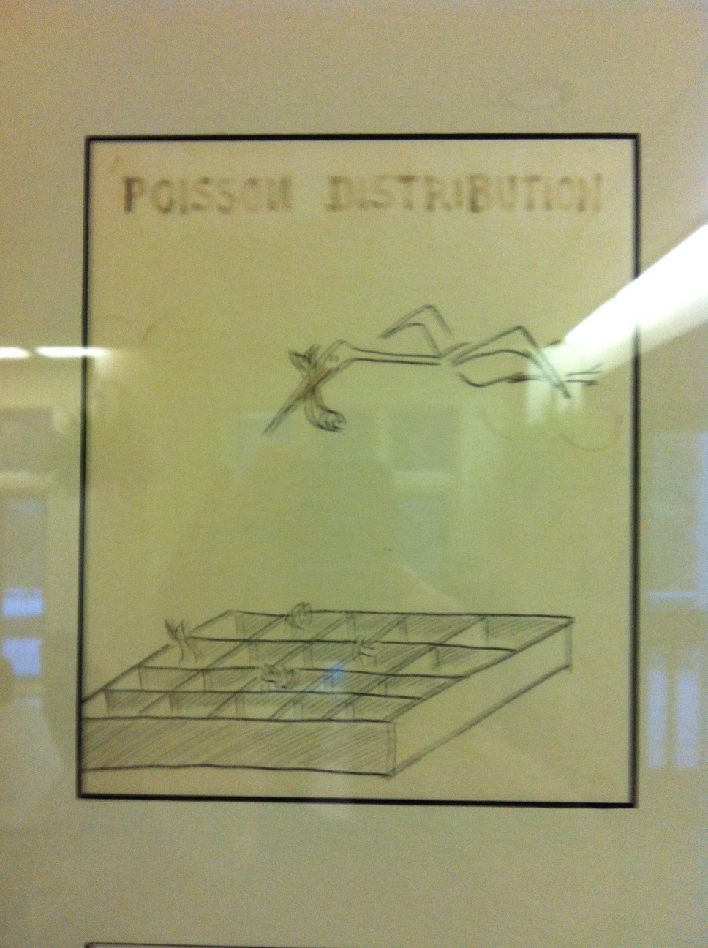
See above the toasters in
Blackford Hall, CSHL

Slide 74
Technical Replicates
R^2=0.999
Log2(rep2_counts+1)
Kidney rna-seq samples
Log2(rep1_counts+1)
Data from Marioni et al. [2008]

Slide 75
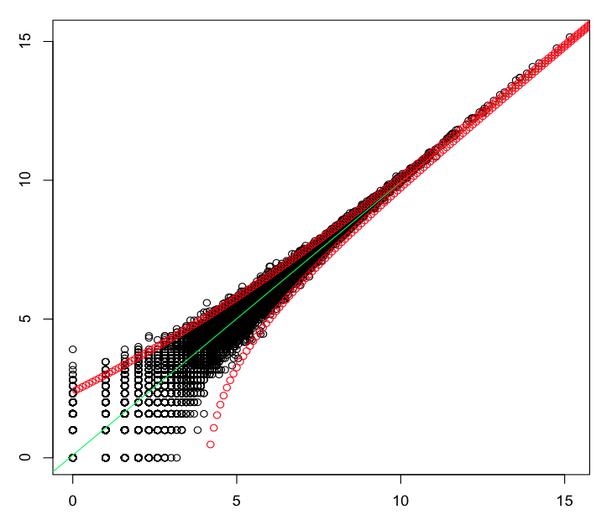
Technical Replicates
Variation observed matches expectations due to random sampling (Poisson distribution)
R^2=0.999
Log2(rep2_counts+1)
Poisson, 4-fold stdev pts shown
Kidney rna-seq samples
Log2(rep1_counts+1)
Data from Marioni et al. [2008]

Slide 76
Poisson well-describes variation observed in technical replicates.
Negative binomial (overly dispersed poisson) better models biological replicates.

Slide 77
Comparing Samples and Identifying Differentially Expressed Transcripts

Slide 78
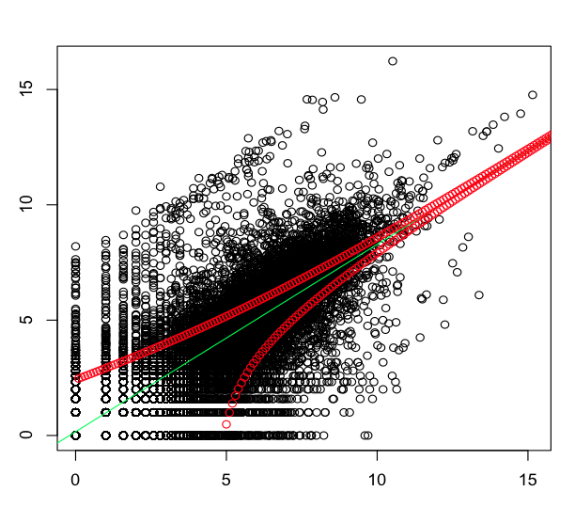
Kidney vs. Liver
Log2(liver+1)
Log2(kidney+1)

Slide 79
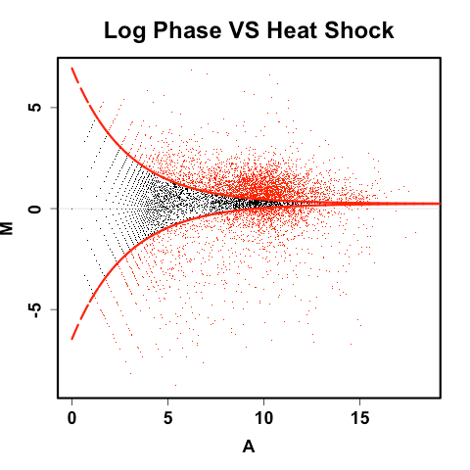
Increased Power for Identifying Differentially Expressed Transcripts With Deeper Sequencing
MA plot: log(Counts) vs. log(Fold change)
Log2(fold change)
* 2-fold is NOT stat significant here.
* 2-fold is stat significant here.
Average log2(counts)

Slide 80
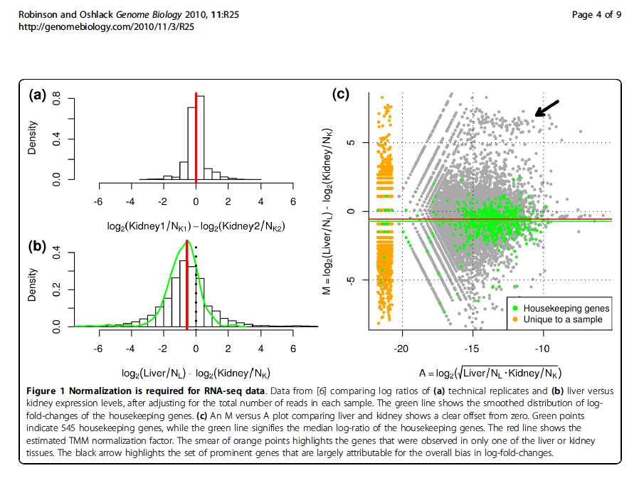
Normalization Required Otherwise, housekeeping genes look diff expressed due to sample composition differences
Subset of genes highly expressed in liver
Technical replicates
Liver - kidney
Robinson and Oshlack, Genome Biology, 2010
Notes:
Pushes relative concentration of the other liver transcripts down.

Slide 81
Identifying Differentially Expressed Transcripts
Statistical tests performed on fragment counts (not FPKM values).
Given observed read counts for a transcript in each of two samples, what’s the probability they were derived from the same distribution (null hypothesis)? (ex. Fishers exact test)
If (P <= 0.05), significantly different
Don’t forget to adjust P-values due to false discovery rate (FDR) resulting from running many (thousands of) statistical tests. (ex. use Q-values)
Notes:
Fdr = expected proportion of errors among the rejected null hypotheses.

Slide 82
Experimental Design
Forego technical replicates
Ideally, have at least 3 biological replicates
Without biological replicates, can still model variation based on parametric distributions (eg. Negative binomial), but expect lower accuracy.

Slide 83
Statistical Analysis Software for Identifying Differentially Expressed Transcripts
Bioconductor
EdgeR
DEGseq
DESeq
And others…
Tuxedo suite
Cuffdiff
(analysis enabled with CummeRbund/Bioconductor)

Slide 84
Examples of Results
(Cuffdiff)
0 test_id
1 gene_id
2 gene
3 locus
4 sample_1
5 sample_2
6 status
7 value_1
8 value_2
9 log2(fold_change)
10 test_stat
11 p_value
12 q_value
13 significant
XLOC_000024
XLOC_000024
-
7000000090838467:1335927-1338056
condA
condB
OK
680.167
68932
6.66314
-2.91993
0.00350111
0.0424377
yes

Slide 85
Examples of Results (example edgeR)
comp217_c0_seq1
6.69056684523186
16.1146897543805
2.06844466442231e-15
9.01969581996253e-13
0 logFC
1 logCPM
2 PValue
3 FDR

Slide 86
Trinity Differential Expression Workflow
Sample_A
Sample_B
Sample_C
Combined samples
Align reads to Trinity transcripts using Bowtie
Trinity Assembly
Estimate transcript abundance using RSEM
Statistical analysis to identify significantly differently expressed transcripts using Bioconductor

Slide 87
Tuxedo Differential Expression Workflow
Sample_A
Sample_B
Sample_C
Align reads to Genome using TopHat
Reconstruct Transcripts and Quantify Abundance
Using Cufflinks
Merge Transcripts using Cuffmerge
Differential Expression Analysis using Cuffdiff

Slide 88
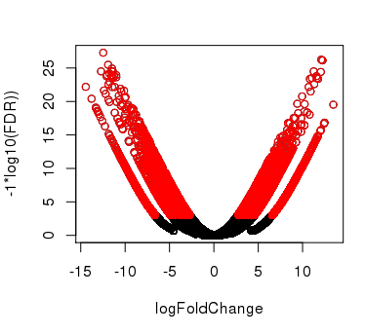
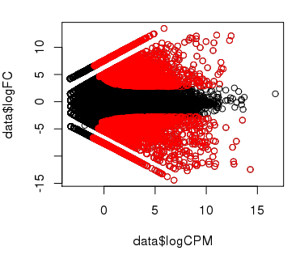
Plotting Pairwise Differential Expression Data
Volcano plot
( fold change vs. significance)
MA plot
(abundance vs. fold change)
(expression level)
Significantly differently expressed transcripts have FDR <= 0.001
(shown in red)
No replicates available, so modeled by edgeR using the Negative Binomial with dispersion manually set to 0.1
Notes:
data= read.table("CNS_vs_Mus.results.txt")
signif = data$FDR<= 0.001
plot(data$logFC, -1*log(data$FDR,10), xlab="logFoldChange", ylab="-1*log10(FDR))")
points(data$logFC[signif], -1*log(data$FDR[signif],10), col='red')
plot(data$logCPM, data$logFC)
points(data$logCPM[signif], data$logFC[signif], col='red')

Slide 89
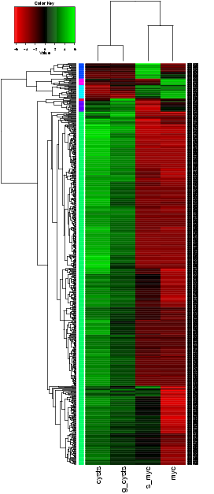
Comparing Multiple Samples
Heatmaps provide an effective tool for navigating differential expression across multiple samples.
Clustering can be performed across both axes:
-cluster transcripts with similar expression patters.
-cluster samples according to similar expression values among transcripts.

Slide 90
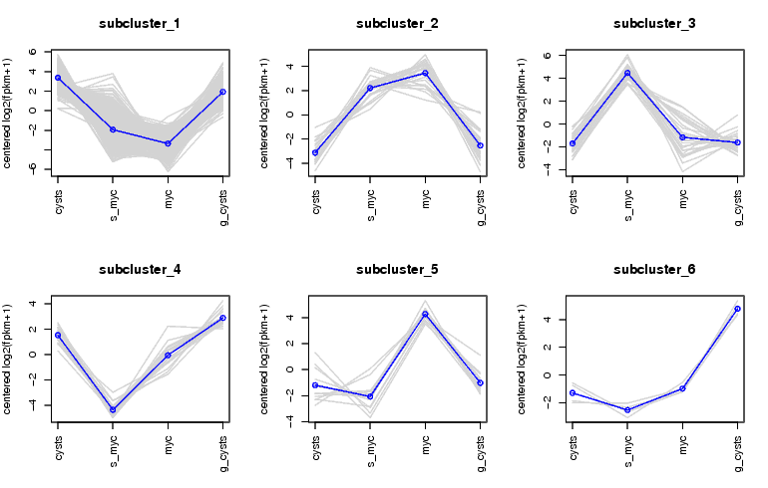
Examining Patterns of Expression Across Samples
Can extract clusters of transcripts and examine them separately.

Slide 91
Hands-on Tutorials
Tuxedo
Tophat alignment
Cufflinks transcript reconstructions
GenomeView for navigating the alignments
Cuffdiff for differential expression analysis
cummeRbund for exploring diff. express. results.
Trinity
De novo assembly using Trinity
Bowtie and RSEM for abundance estimation
edgeR for differential expression analysis

